Slide 1

Triip
AI Travel Copilot for Gen Z
Arnab Das | Student code : iitp_pm_2504495
Final Project Submission

Slide 2
Agenda
Project Overview
1. Product Requirements Document (PRD) Summary
2. UX Showcase & Prototypes
3. Technical Decision Document (TDD) Summary
Stakeholder Briefing
1. Goals & Success Metrics
2. Responsible AI & Trust
3. The Gen Z User Experience
4. Conclusion & Future Roadmap

Slide 3
Executive Summary
❓ The Problem: Gen Z travelers face "analysis paralysis" from overwhelming online information.
💡 Our Solution: Triip is a generative AI "Travel Copilot" that delivers customized, trustworthy itineraries in seconds.
📈 The Impact: We provide a delightful, fast, and responsible planning experience, backed by a successfully implemented, fine-tuned AI model.

Slide 4
Comprehensive Product Requirements
To understand what we're building and why, we created a detailed Product Requirements Document (PRD). The following slides dive into the key highlights, from the market gap to our target users. The complete document is linked below for a deeper dive.
View Full Product Requirement Document (PRD)
Click Here

Slide 5
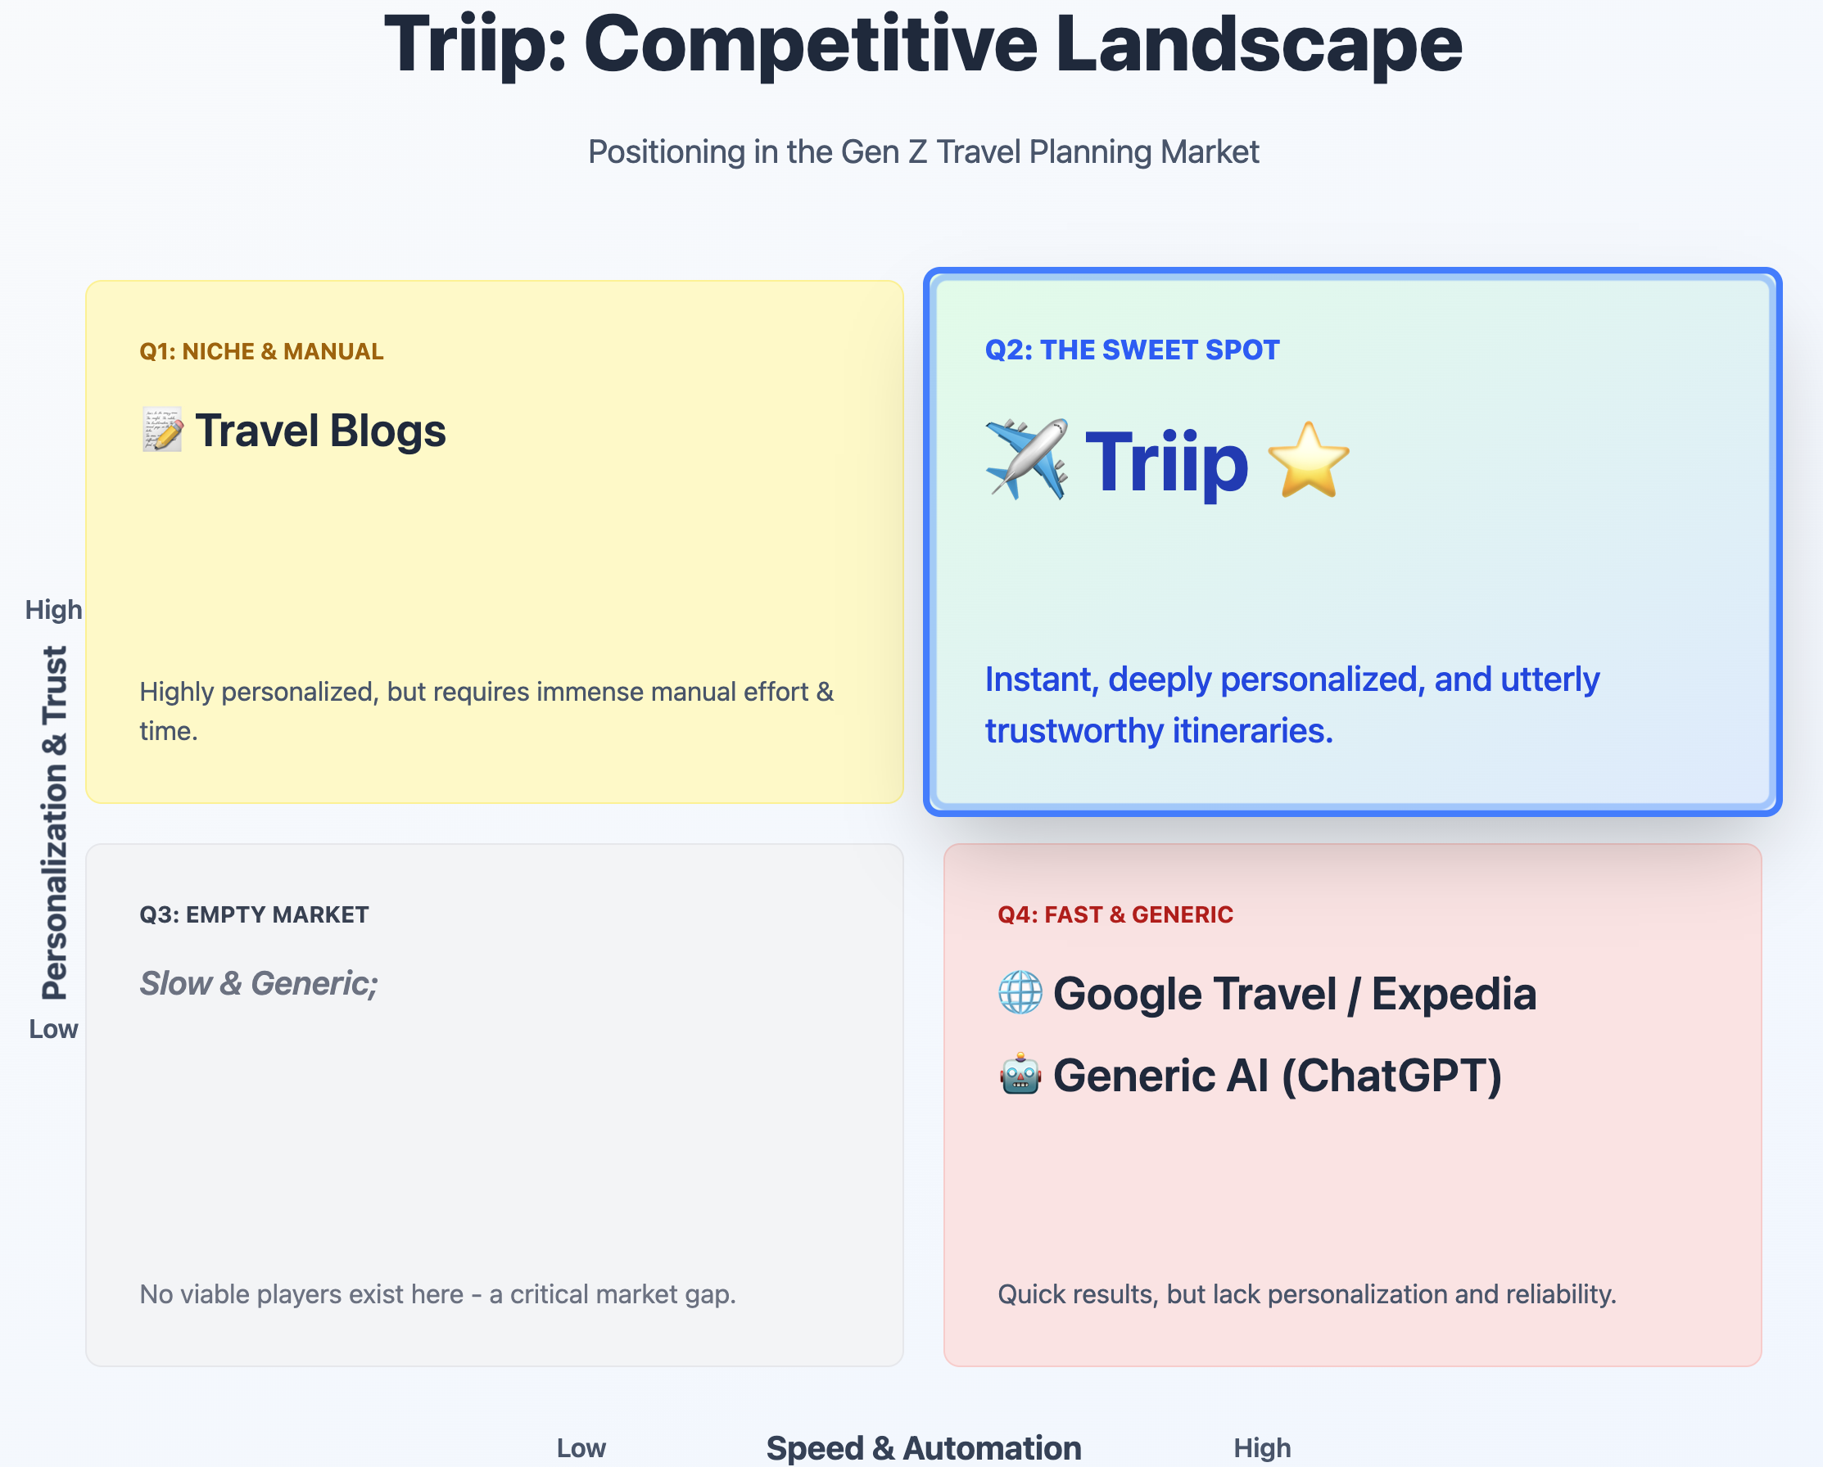
The Problem & The Market Gap
Key Statistic (make this large): 72% of Gen Z travelers feel overwhelmed by travel planning.
The Gap:
Competitors like Google Travel, Make My Trip (MMT), blogs, and generic AI are too broad, slow, or untrustworthy for Gen Z's specific needs.
Not everything is fast and integrated to match the vibe of our Gen Z users.

Slide 6
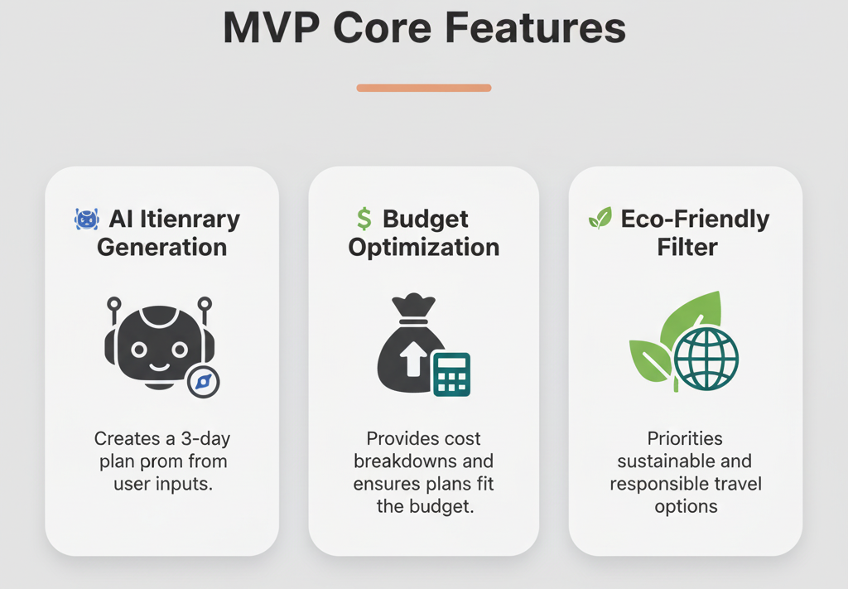
Our Solution: TRiip The AI Travel Copilot ✨
Core Value Prop: "A Gen Z-friendly, instant travel buddy for hassle-free planning."

Slide 7
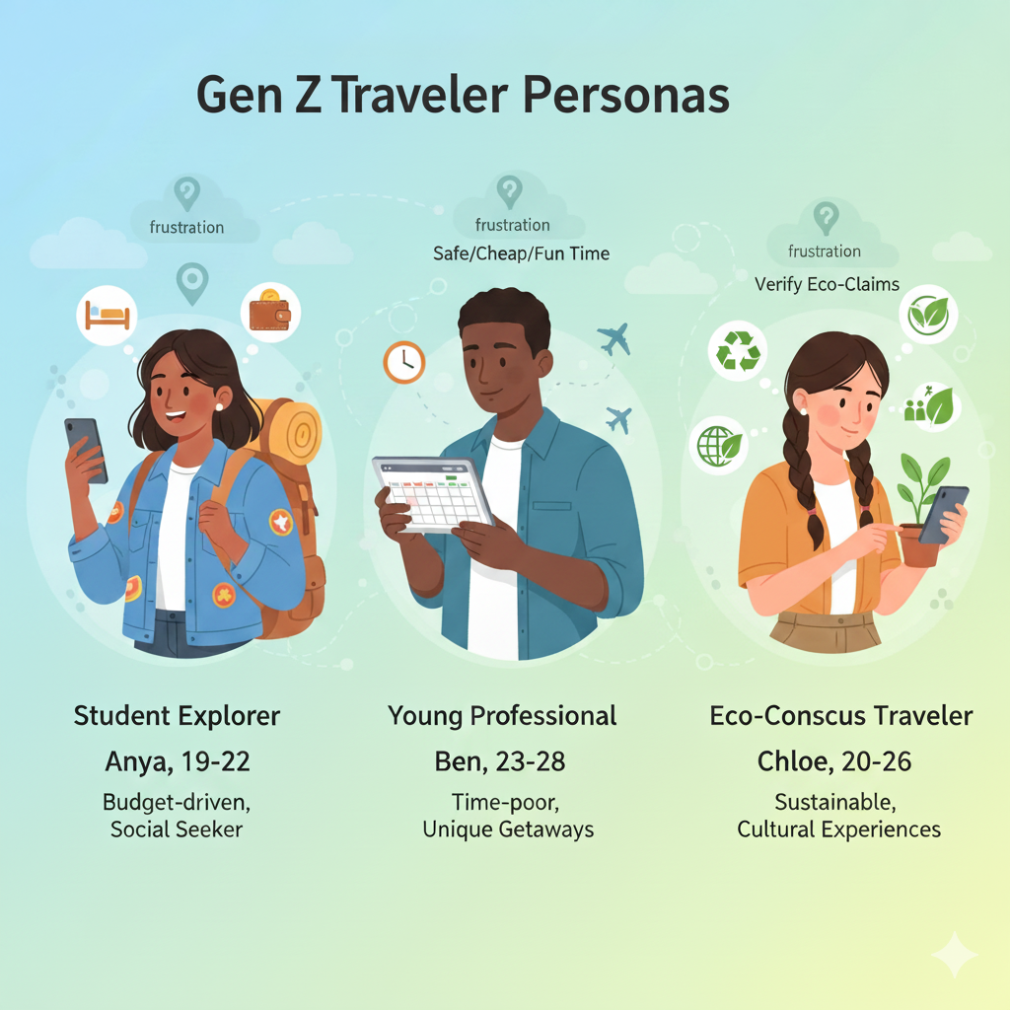
Understanding Our Users: Gen Z Personas 👥
1. Anya (The Student Explorer 🎒): Budget-driven, seeks social fun.
2. Ben (The Young Professional 👔): Time-poor, seeks efficient, unique getaways.
3. Chloe (The Eco-Conscious Traveler 🌍): Value-driven, seeks sustainable, cultural trips.

Slide 8
Comprehensive Technical Decisions
The following slides detail our robust and scalable technical strategy, which has been validated with a working MVP. The full documentation is linked below.
View Full Technical Decision Document (TDD)
Click Here

Slide 9
The Core Decision: Why Fine-Tune a Model? 🤔
Approach | Characteristics
Generic AI (Prompting) | ❌ Higher Hallucination ❌Lacks Domain Nuance ❌Inconsistent
Triip's Approach (Fine-Tuning) | ✅ High Accuracy ✅ Domain Expert ✅ Controlled & Safe ✅ Consistent

Slide 10
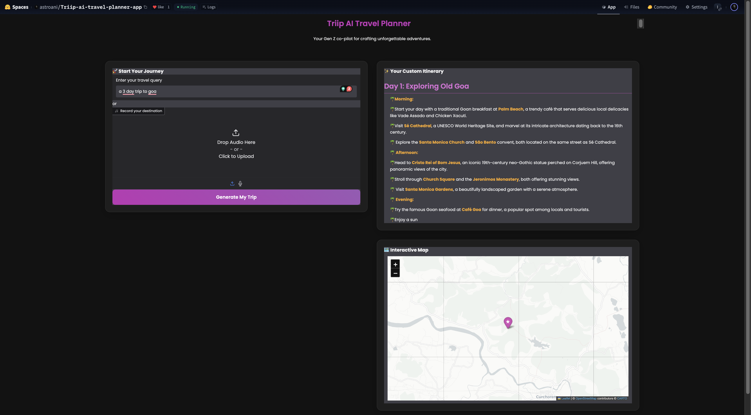
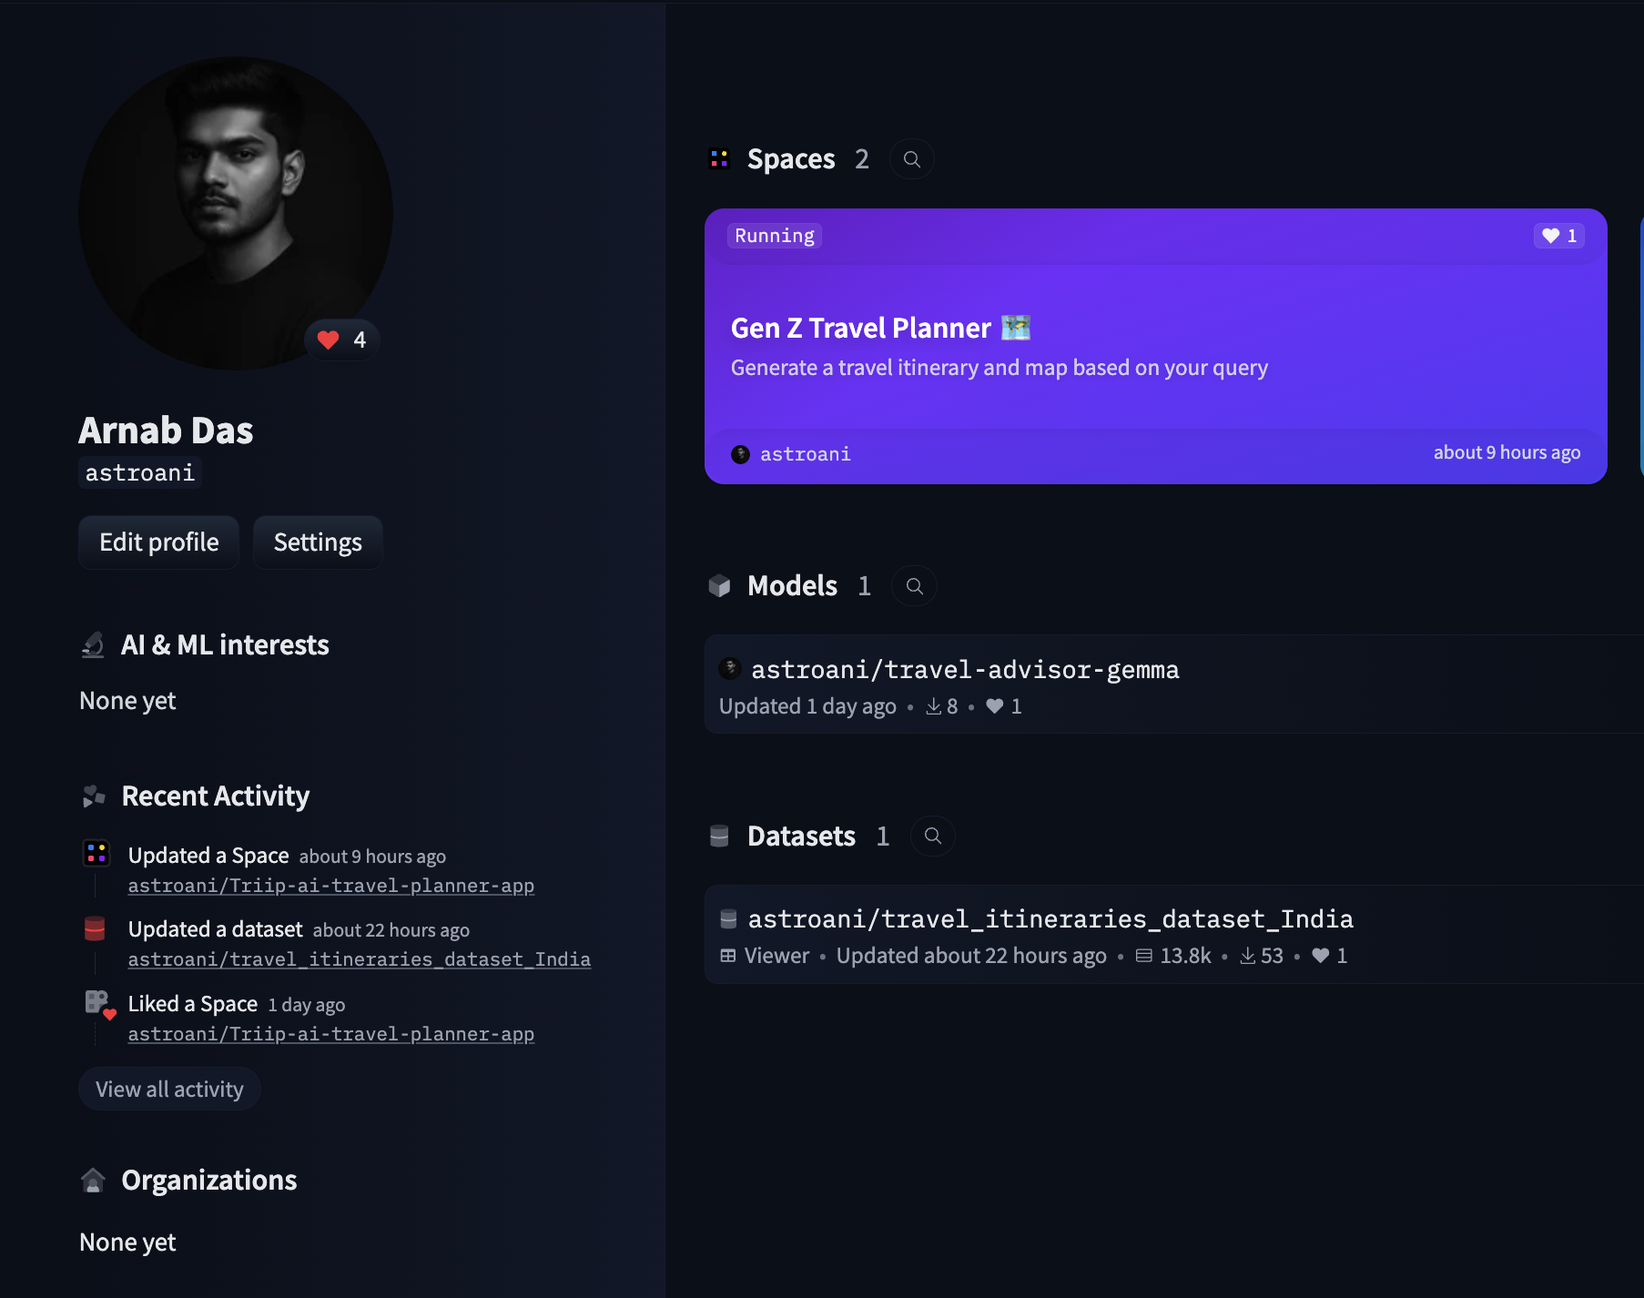
Our Live AI Model & Custom Dataset 🚀
The Model: We successfully fine-tuned a Gemma model using PEFT/LoRA. The working model is live on Hugging Face.
The Data: The model was trained on our custom-built dataset of Indian travel itineraries to ensure quality.
Click on Image to re-direct

Slide 11
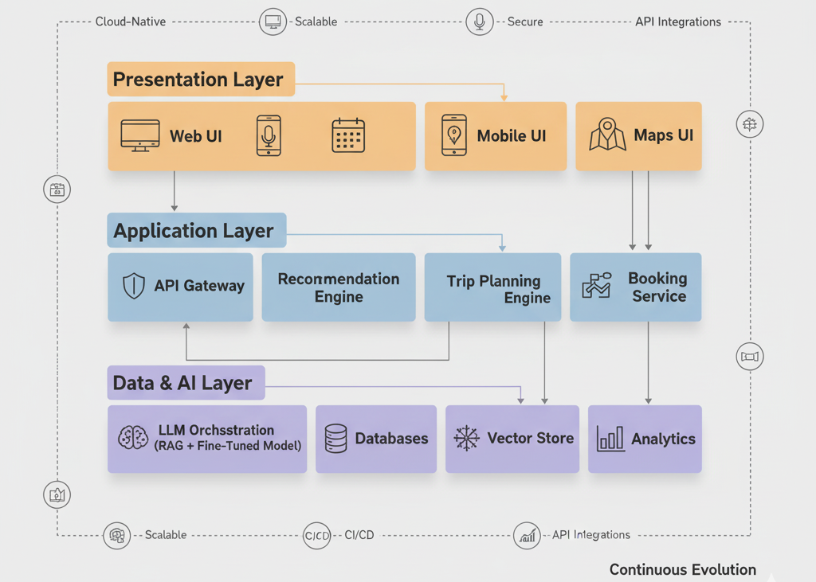
System Architecture: From MVP to Scale 🏗️
MVP Architecture (Current): Fully hosted on the Hugging Face ecosystem for rapid prototyping.
Production Architecture (Future): A scalable 3-tier system designed for growth.

Slide 12
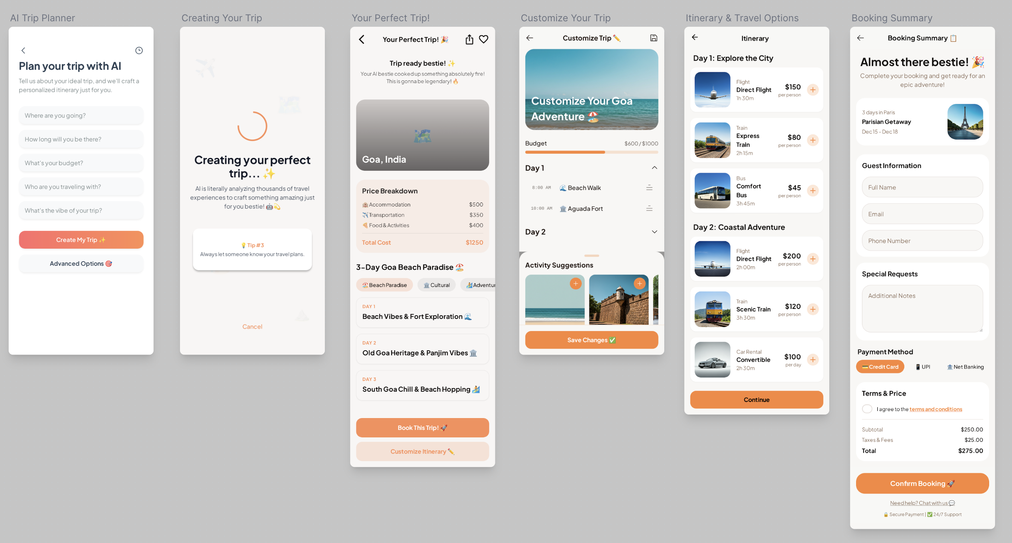
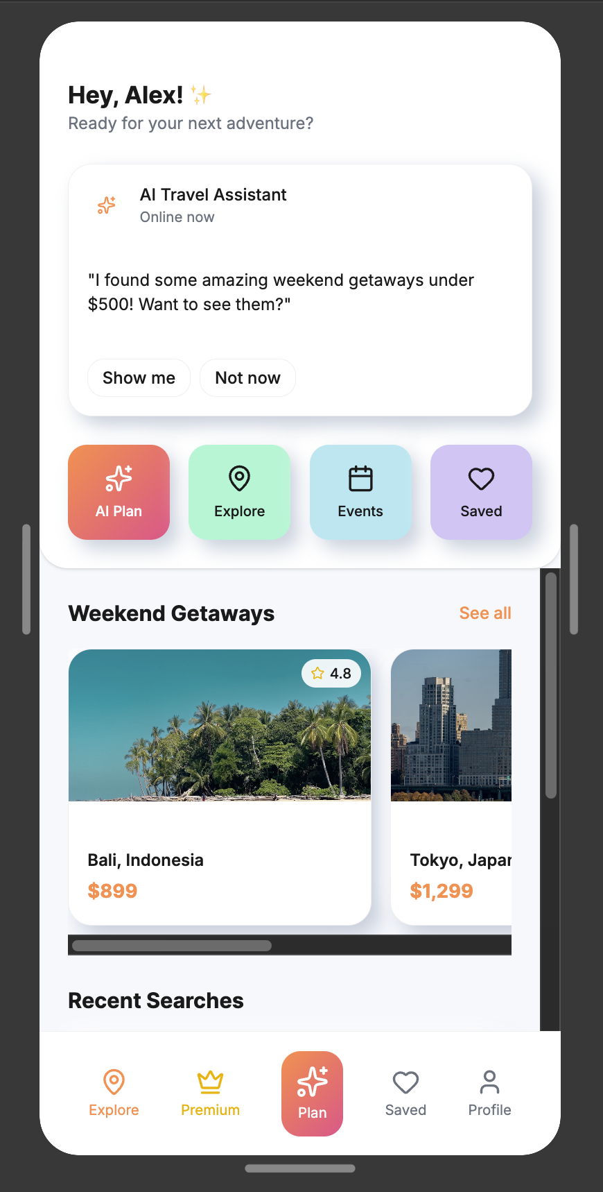
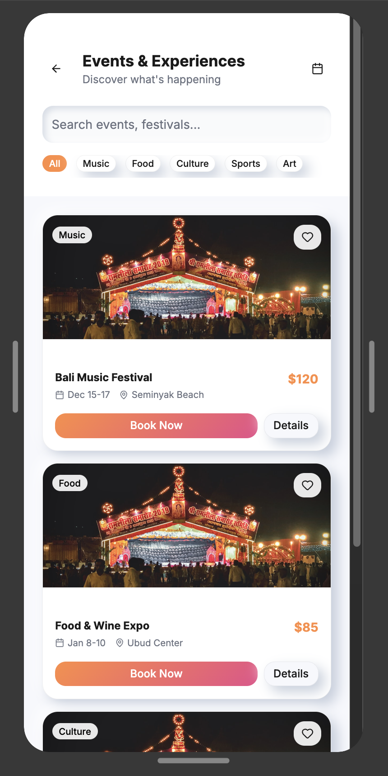
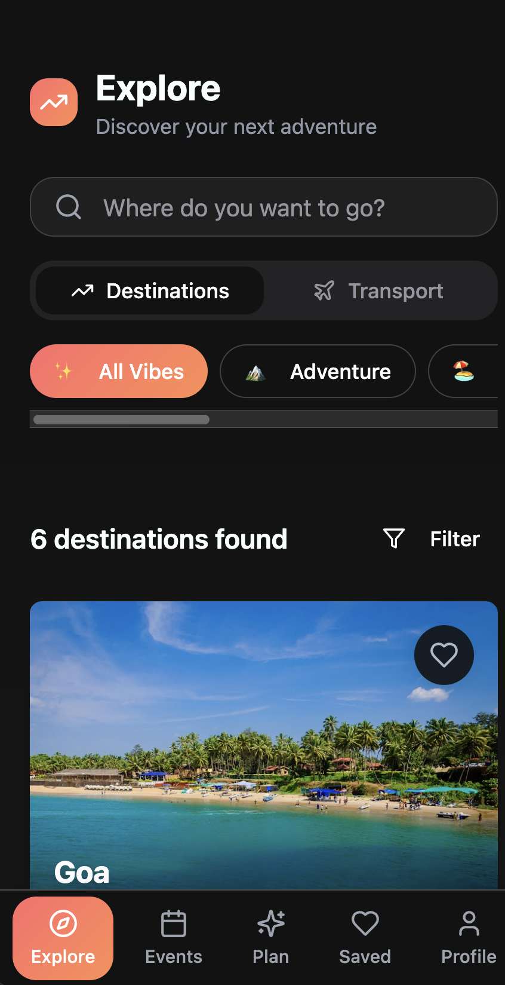
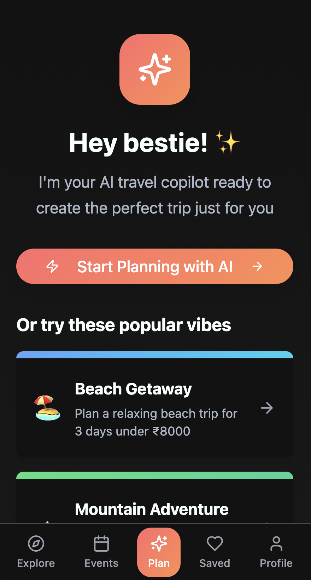
UX Showcase: From Idea to Interface 📱
This slide showcases the evolution of the Triip app from basic wireframes to a polished, user-friendly design.
High-fidelity Clickable Wireframes
Lo-fidelity Wireframes
Working Prototype
Click on Images to land on design pages.

Slide 13

Stakeholder Briefing: The Triip Value Proposition

Slide 14
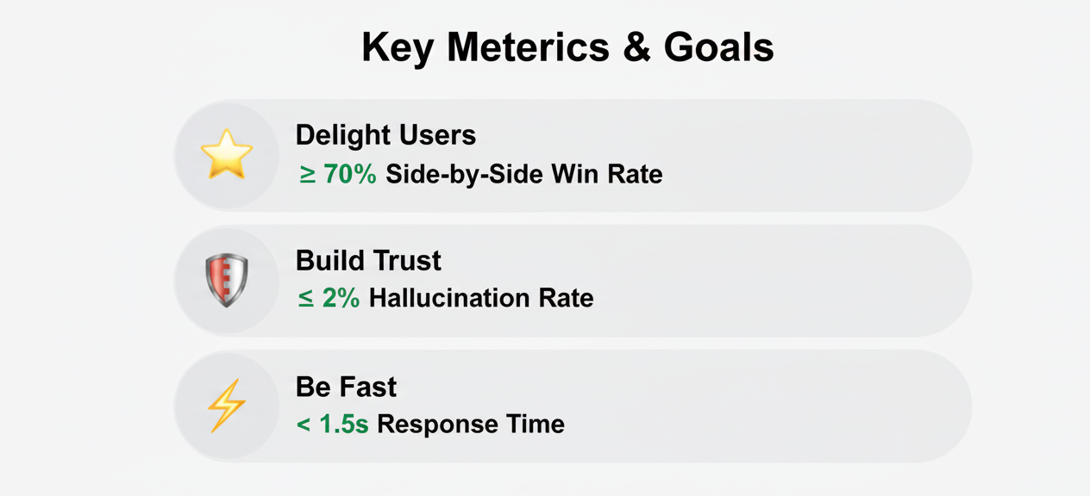
Our Goals & How We Measure Success 🎯

Slide 15
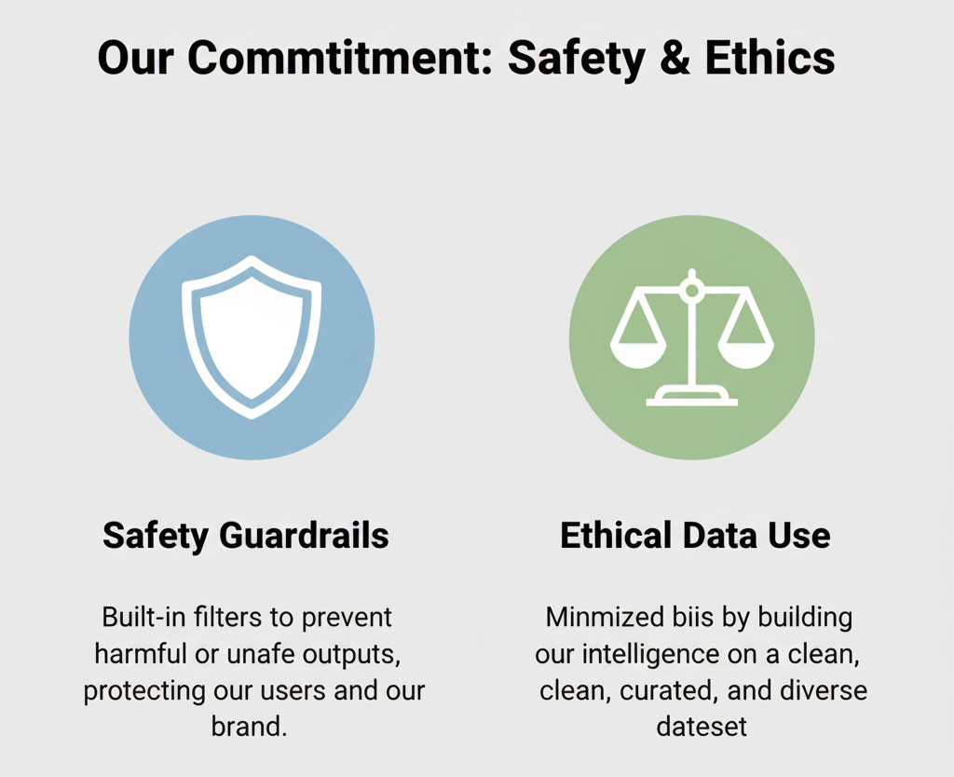
Our Commitment to Responsible AI 🙏

Slide 16
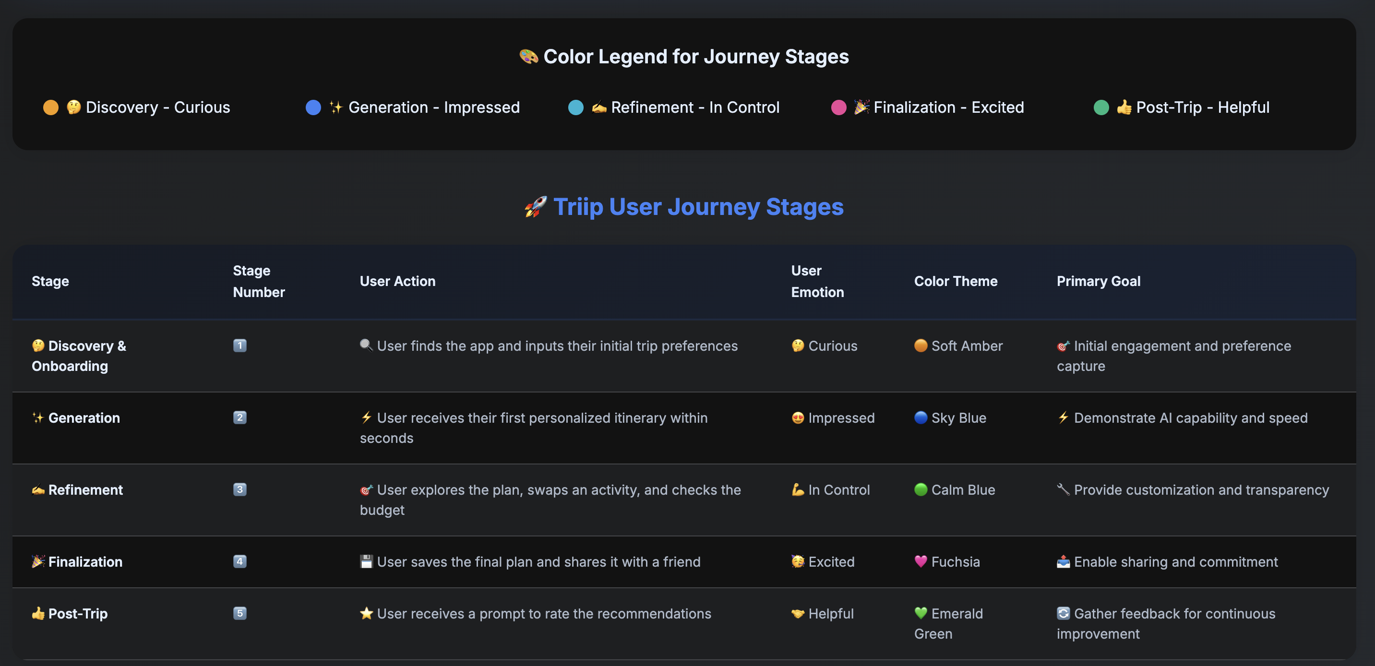
An Experience Built for Gen Z 😊

Slide 17
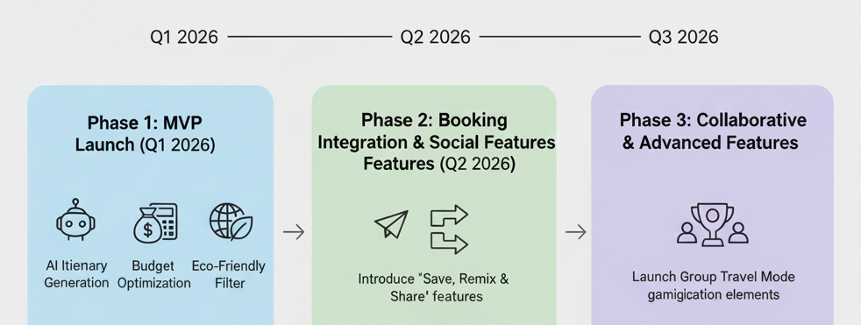
Implementation Plan & Roadmap

Slide 18
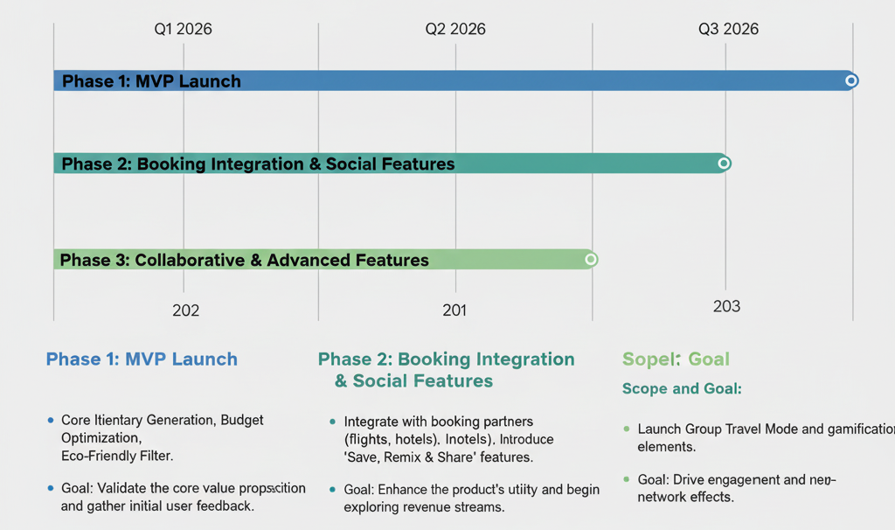
Conclusion & Future Roadmap
Conclusion: Triip is uniquely positioned to capture the Gen Z travel market. Our successful MVP proves our readiness for the next phase of growth.

Slide 19
Q&A ✨
Any QUESTIONS ? Feel Free to Ask Anything. Thank You.
Full Module 4 Final Submission Folder Access:
Click Here

